Slide 1
Rental Analysis of Airbnb Seattle
Manali Nikam
7th October,2019

Slide 2
1.Introduction
Seattle is one of the biggest business and innovation hubs in the country, attracting heavy traffic from tourists and professionals alike. The cities draw people from all walks of life ranging from computer scientists to business owners to startup specialists to tourist groups to college freshmen. Airbnb senses an opportunity to improve their rental programs in these cities and would like to hear your suggestions on how to do so.

Slide 3
1.2 Problem:
The Data that we are working on includes a list of rentals across various locations in Seattle. It gives us information about the number of amenities provided, the number of persons that can be accommodated, room type, property type, the number of reviews that the listing has received.
In this project we will try to find optimal locations for rentals in Seattle neighborhoods listed on Airbnb. We will use DataScience to find which area is most preferred rentals in Seattle neighborhood by the people which can be tourists/professionals.

Slide 4
2. Data Analysis:
Below parameters were used to find accuracy of the model:
host_is_superhost',
'host_has_profile_pic',
'host_identity_verified',
'total_amenities',
'price_per_person',
'cancellation_policy',
'number_of_reviews'

Slide 5
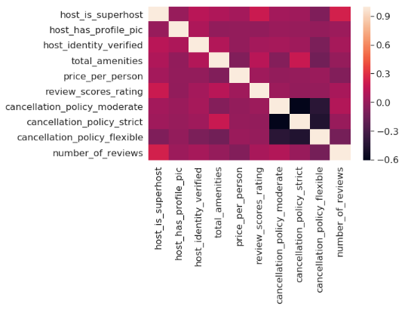
2.1 Heat Map for checking the relationship between the variables

Slide 6
2.2 Classification Report:
I used Naïve Bayes for analysis.
 | Precision | Recall | F-1 Score | Support
Micro avg | 0.95 | 0.95 | 0.95 | 958
Macro avg | 0.61 | 0.64 | 0.62 | 958
Weighted avg | 0.95 | 0.95 | 0.94 | 958
 | Precision | Recall | F-1 Score | Support
Micro avg | 0.95 | 0.95 | 0.95 | 958
Macro avg | 0.61 | 0.64 | 0.62 | 958
Weighted avg | 0.95 | 0.95 | 0.94 | 958

Slide 7
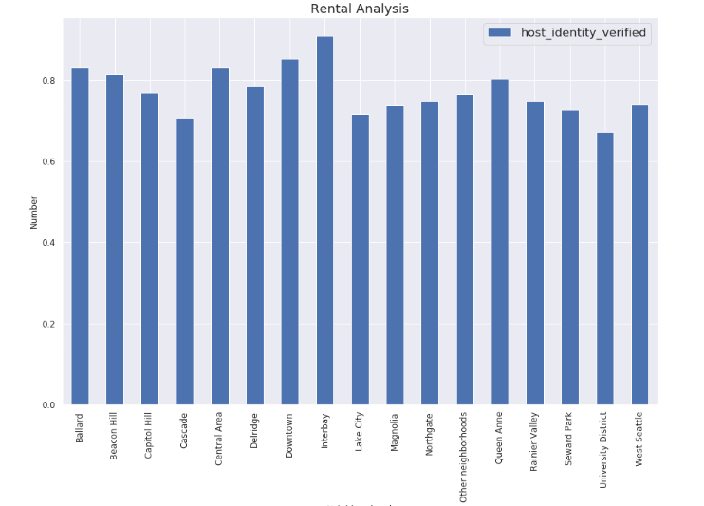
3.Exploratory Analysis
1.Host Identity Verified - It is observed here that most of the rentals across the neighborhoods have verified hosts meaning that the listings are authentic.

Slide 8
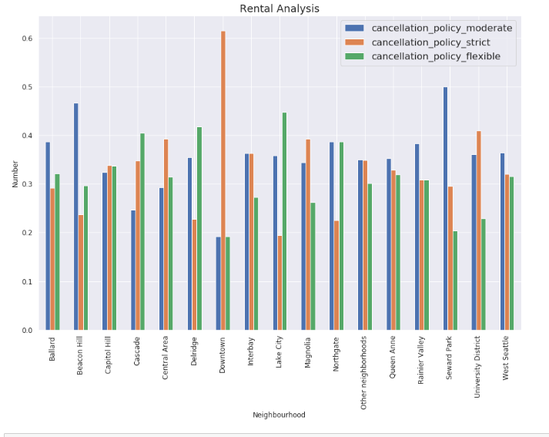
2.Cancellation Policy:
The cancellation policy that most tourists seek will be from moderate to flexible. As per our analysis, the neighborhoods that have high number of reviews have moderate cancellation policy

Slide 9
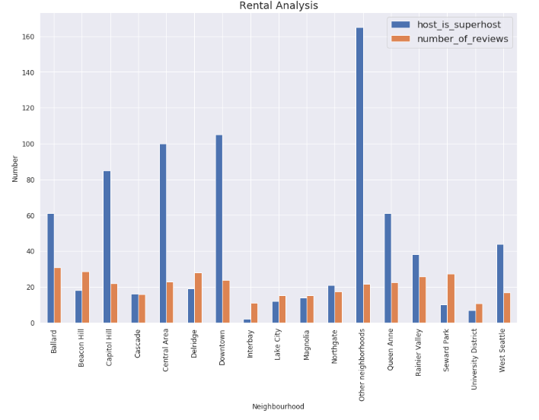
3. Host is superhost:
Host is superhost is one of the factor which can give a higher score to a particular rental hence it cannot be ignored.

Slide 10
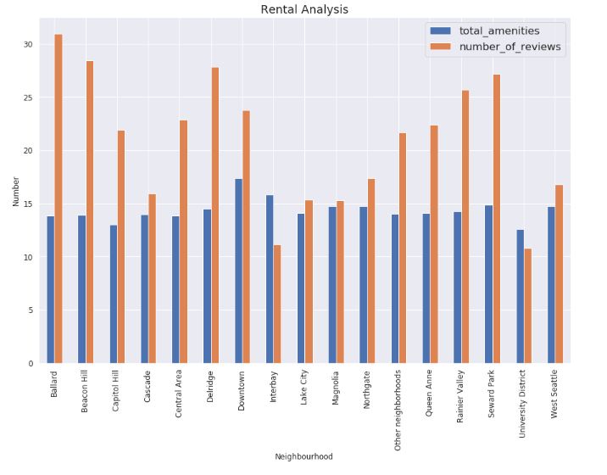
4.Total number of amenities:
The neighborhoods having high number of reviews have upto 15 amenities. These are common amenities which a visitor looks for in a particular rental

Slide 11
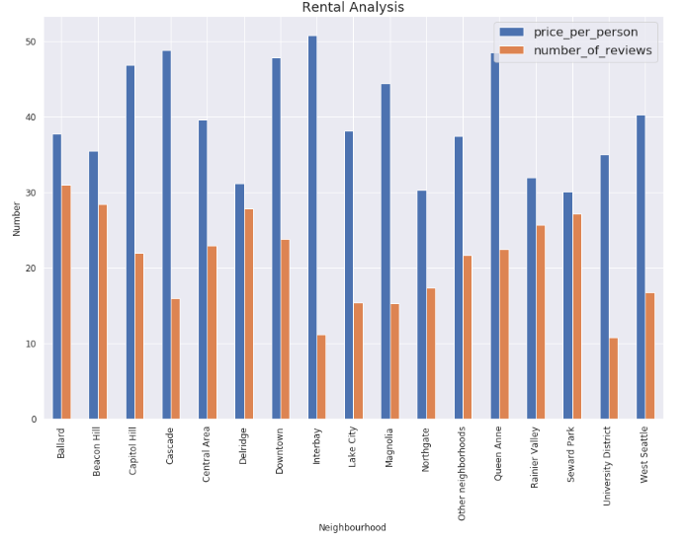
5.Price per person:
As seen in this graph, the price is one of the factor. An average price between 30 to 38$ is how the listings are rated in top 5 neighborhoods.

Slide 12
4.Conclusion
Based on above analysis it was found that Ballard, Beacon Hill, Delridge, Rainier Valley and Seward Park is the most preferred neighborhood for tourists in Airbnb Seattle. They all offer rentals with below facilities:
1.Cancellation policy is moderate.
2.The total number of amenities are 15.
3.Price is between 30$ and 38$ per person.
4.If host is superhost,the listing has more reviews.
5.The host identity is verified.
6.Most rentals have host profile picture making it an authentic rental.
Based on above points, efforts can be made to increase listings in these neighborhoods so that Airbnb can improve their business as well. To improve business on existing rentals in other neighborhoods, amenities and price needs to be worked upon.

